Slide 1
Chapter 1
The world Wide Web
Web Programming

Slide 2
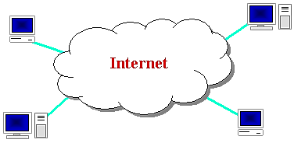
What is Internet?
Internet: a network of networks
Worldwide connection of computers & computer networks using IP that links billions of computers used by businesses, gov’t, educational institutions, organizations, and individuals using modems, phone lines, television cables, satellite links, fiber-optic connections, & other communications devices & media
Several applications:
    E-mal
    www
    File transfer (FTP)
    Remote login
    E-commerce
    Instant messaging (chat)
    Mailing lists

Slide 3
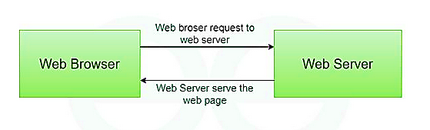
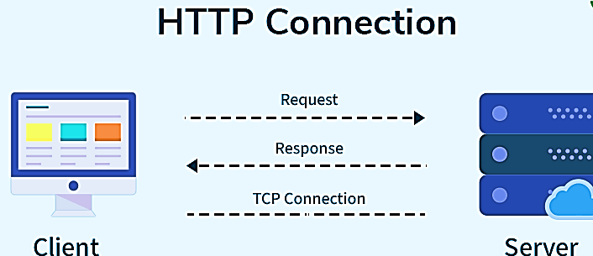
Protocols
  Protocol & Hypertext Transfer Protocol (HTTP)
  A protocol is a set of rules that govern communication between two or more systems, while HTTP (Hypertext Transfer Protocol) is a specific application-layer protocol that enables data exchange on the World Wide Web.
  HTTP defines how web browsers and servers communicate to request and send resources like HTML pages, images, and videos

Slide 4

What is the World Wide Web?
The World Wide Web is a system of interconnected documents and resources, like websites and videos, that are accessed over the internet.
It is a collection of public webpages, linked by hypertext, that are identified by unique URLs and viewed through a web browser.
The World Wide Web is a service that runs on top of the Internet, which is the larger global network of computers

Slide 5
Cont’d
A collection of resources:
  Web pages (static / dynamic)
  Media files (images, animations, sound, …)
  Style files (CSS)
  Documents (pdf, doc, txt, rtf, …)
Has a globally unique name
  E.g. www.jku.edu.et
Stored on machines called web servers
Home page: first document users see when they access a web site

Slide 6
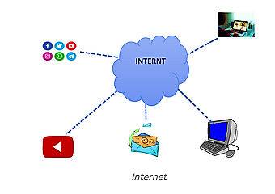
Internet vs Web
Internet & web are not the same things.
Internet: a inter-connected computer networks, linked by wires, cables, wireless connections, etc.
  They have communication between each other.
  Decentralized design that there is no centralized body controls how the Internet functions.

Slide 7
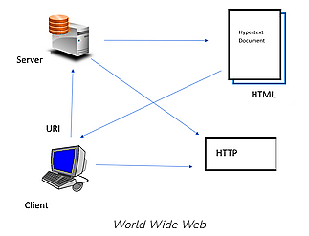
Internet vs Web
Web: a collection of interconnected documents and other resources that are interconnected by hyper-links.
  These documents are accessed by web browsers and provided by web servers.
Web server: web pages to be visible to people on the Internet, a machine with a connection to the Internet running special “web server software”.

Slide 8
Cont’d
How does the Internet work?
  Through communication protocols
  Communication protocol is a specification of how communication between two computers will be carried out
  IP (Internet Protocol): defines the packets that carry blocks of data from one node to another
How does the www work?
Websites (with unique names) are stored on web servers
Users access these websites via the Internet using software called a web browser.
A user sends requests for resources from a server with the help of the a user agent (browser)
The server sends the requested resource to the user agent
The user agent renders the resource for the user to view.

Slide 9
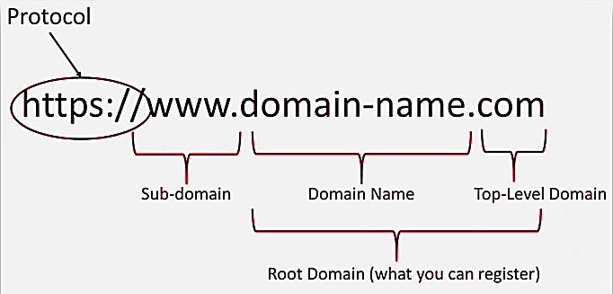
Cont’d
Domain Name System (DNS)
The Domain Name System (DNS) name structure is a hierarchical tree structure called the domain namespace.
Domain names are read from right to left, with each part (called a label) separated by a dot (.), and they get more specific as you move left.

Slide 10
Cont’d
Top Level Domain’s
Some Common TLDs
  COM (originally intended for US business, has become the defacto top level domain)
  NET
  ORG (for non-profit organizations)
  EDU (educational institutions)
  GOV (governments)
  Country Specific (US, UK, CA, AU, IN, EU, etc)
    Example: www.cs.jku.edu.et → 213.55.85.42
Hierarchical in nature (eg. cs.jku.edu.et)
cs is under jku (subdomain of jku), jku is under edu, edu under et
Labels separated by . (dot)

Slide 11
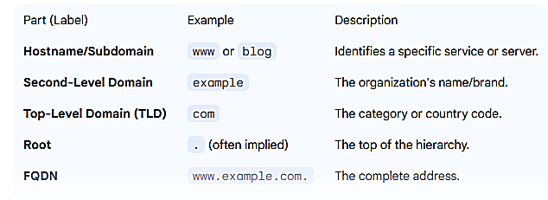
Cont’d
Fully Qualified Domain Name (FQDN)
An FQDN is the complete domain name for a specific computer or host on the Internet. It is unambiguous because it specifies the full path from the host all the way to the root.
    Example: www.example.com

Slide 12
Uniform Resource Locator (URL)
A URL is the complete address used to locate and access a specific resource (like a webpage, image, or document) on the internet.
A typical URL looks like this: https://www.example.com/blog/article.html?id=123
Basic Parts of a URL
Part | Example | Function
Protocol (Scheme) | https:// | Specifies the rule set for exchanging data (e.g., HTTP for basic web data or HTTPS for secure, encrypted data).
Domain Name (Host) | www.example.com | The human-readable name of the website's server. This is the part that DNS translates.
Path | /blog/article.html | Specifies the exact location or file path of the resource on the server.
Query | ?id=123 | Optional information passed to the server, often for dynamic content (e.g., search terms or filters).

Slide 13
Design Good Website
Good website design is not just about:
  Pretty colors,
  Groovy graphics, and
  Knocking out code with software like Dreamweaver
Good website design requires substantial planning, content and the way information is arranged, as well as accessibility and usability for people with varying degrees of ability.

Slide 14
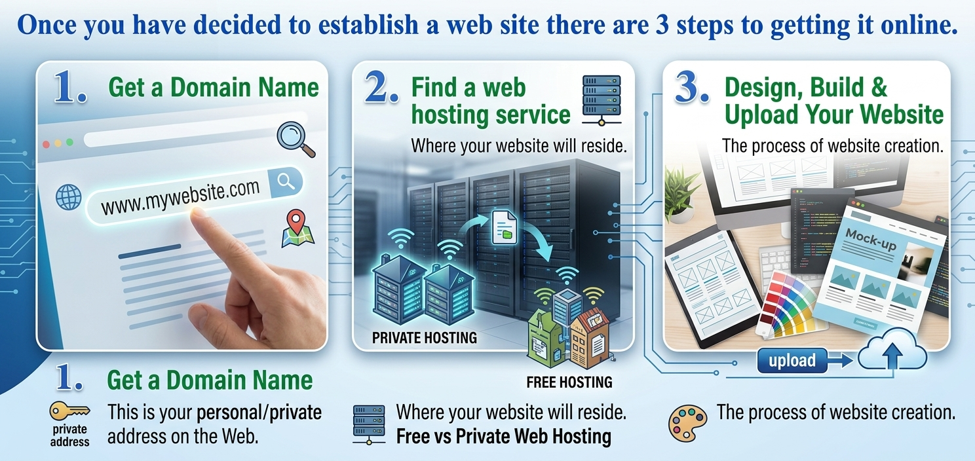
Cont’d…

Slide 15
Web Application
Are applications whose functionality is processed on a web server, and is delivered to the end users over a network such as the Internet.
End users use a thin client (web browser) to run web applications, which knows how to display and execute the data received from the server.

Slide 16
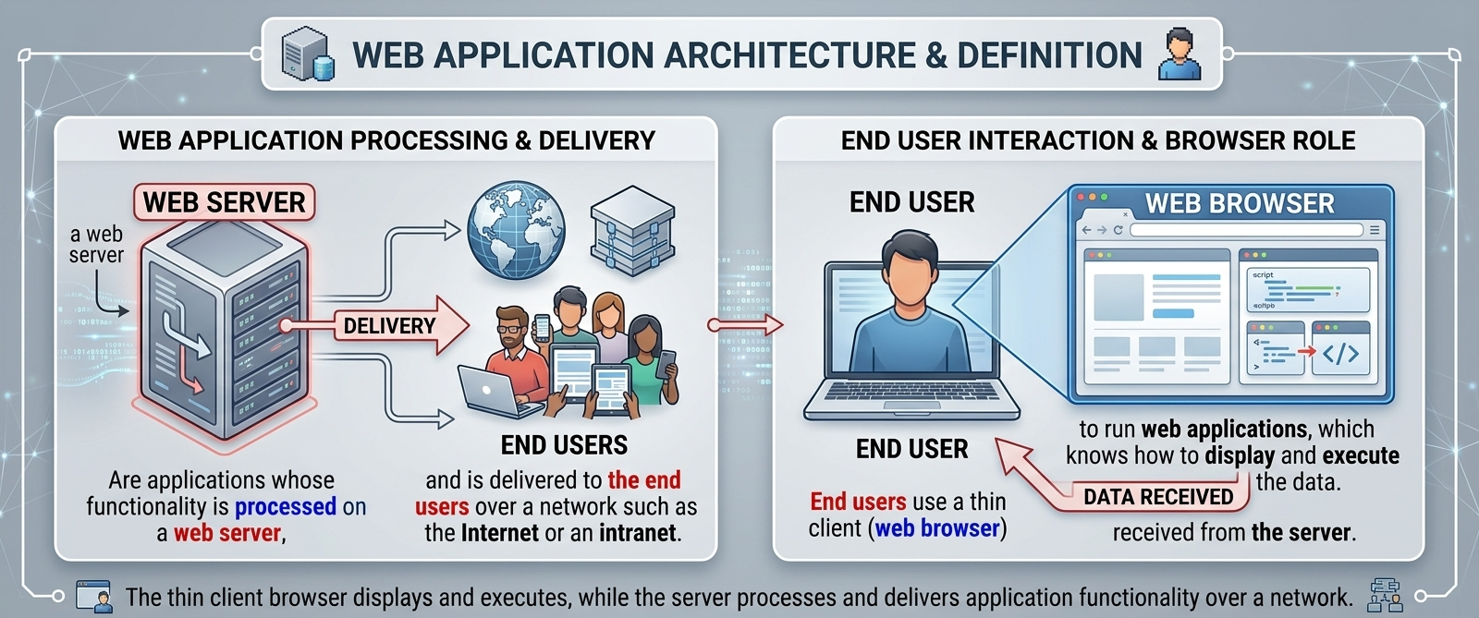
Cont.

Slide 17
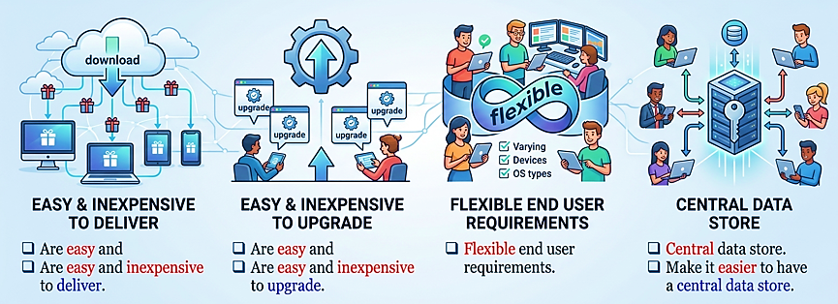
Advantages of Web Applications

Slide 18
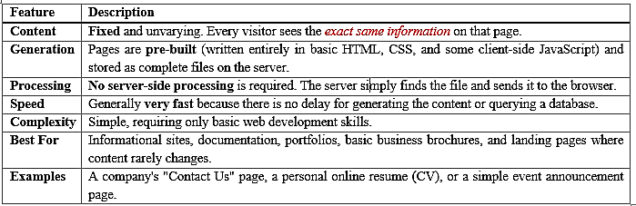
Types of Web Pages
Web pages are generally categorized into two main types based on how their content is generated and delivered to the user's browser: Static and Dynamic.
Many modern websites use a combination of both, sometimes referred to as a Hybrid approach.
Static Web Pages
The content does not change based on the user, time of day, or other variables.

Slide 19
Cont’d…
Dynamic Web Pages
A dynamic web page is one whose content is generated on the fly when a user requests it. The content can change based on user input, server-side data, time, or other factors.
Feature | Description
Content | Content changes based on the user, their actions, or a database query.
Generation | Pages are built in real-time by the server using code, often fetching data from a database and combining it with templates.
Processing | Requires server-side processing (using languages like Python, PHP, Node.js, Ruby, etc.) and a connection to a database.
Speed | Can be slightly slower to load than static pages because of the time required for server processing and database queries.
Complexity | Complex, requiring knowledge of server-side programming, databases, and application frameworks.
Best For | Web applications, e-commerce stores, social media, content management systems (CMS), and any site requiring user interaction.

Slide 20
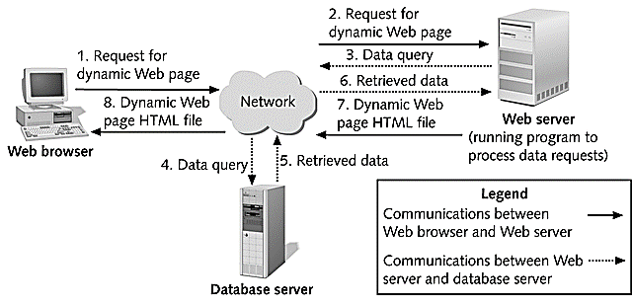
Approaches for Creating Dynamic Web Pages
Dynamic Behavior Can Occur in Two Locations:
Server-Side Dynamic: The page content is assembled on the web server before being sent to the browser. (e.g., A news site generating a list of today's headlines from a database).
Client-Side Dynamic: The content is generated or modified by scripts (usually JavaScript) running within the user's browser after the initial page is loaded.

Slide 21
Client Side vs. Server Side Web
The roles of the Client and Server in a web server environment is fundamental to understanding how the internet works. Here is a list of their respective functions and characteristics:
The Client
The client is typically the web browser (like Chrome, Firefox, Safari, etc.) or any device/application that initiates a request for a web resource.
  The entity that requests services and resources.
  Usually runs on the end-user's device (desktop, laptop, smartphone, tablet).
The Server
The server is a powerful computer or program that provides the resources and services requested by the client.
  The entity that fulfills requests by providing resources.
  Runs on a remote, powerful computer constantly connected to the internet.

Slide 22
The End!
Thank You

